Slide 1
Detecting Anomalies in Servo Motors Using Machine Learning
Course: Autonomous Robots
Sahar Tuvyahu
Yehonatan Baruchson
Guy Gur-Arieh
Harel Gilad

Slide 2
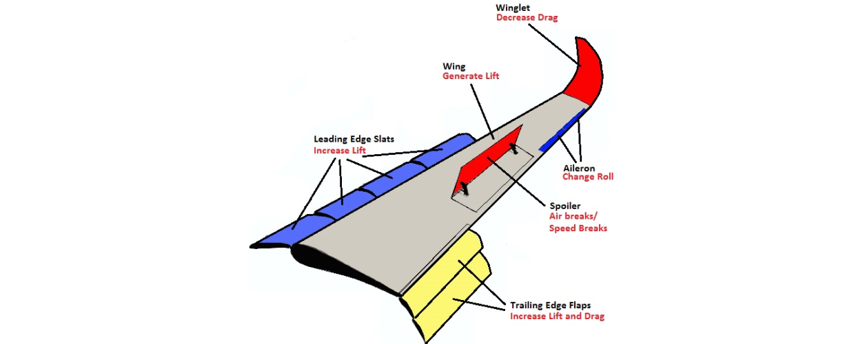
Introduction
Objective: Detect anomalies that could indicate a breakdown of servo motors using a machine learning model.
Motivation: Prevent servo motor failures in critical applications, such as airplane wing control surfaces.

Slide 3
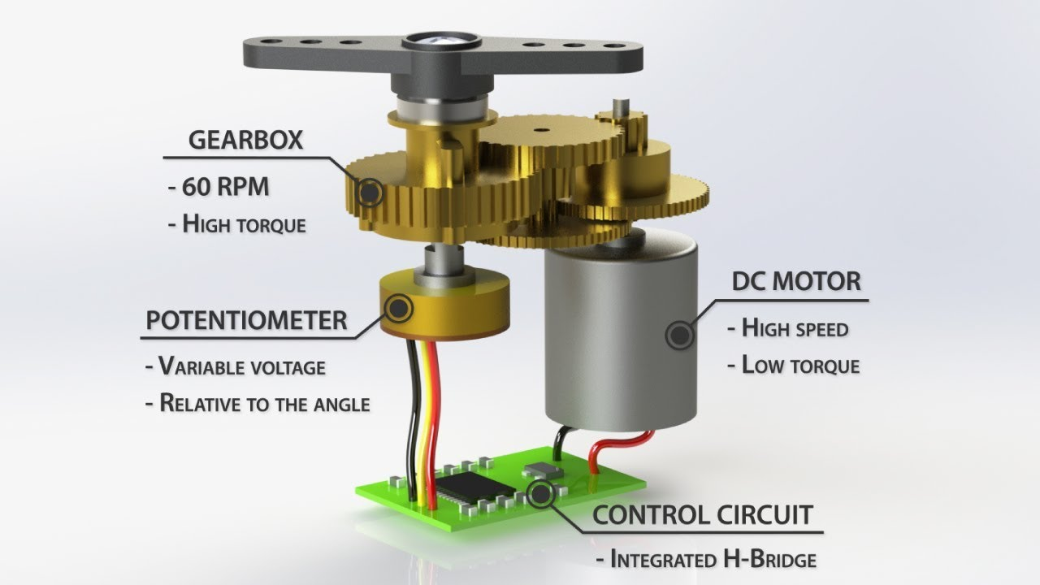
Servo motors:
Types:
180° Servo: typically used for precise angular control.
360° Servo: Continuous rotation.
Applications:
Robotics
Remote control vehicles
Automated machinery
Aerospace control surfaces
etc.

Slide 4
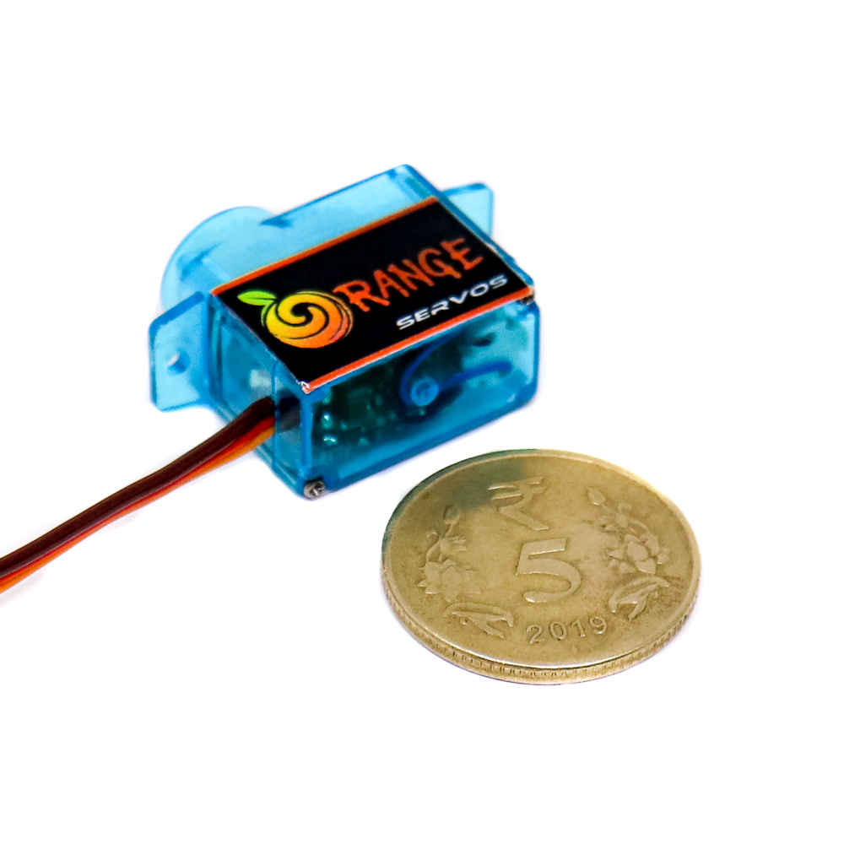
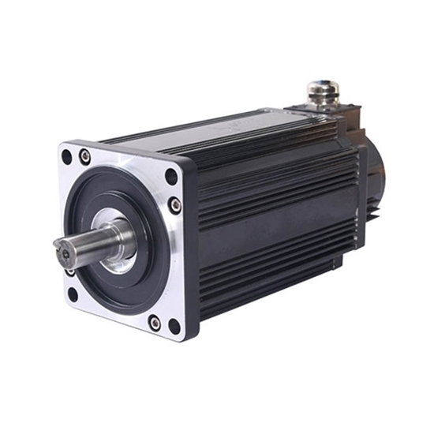

Slide 5
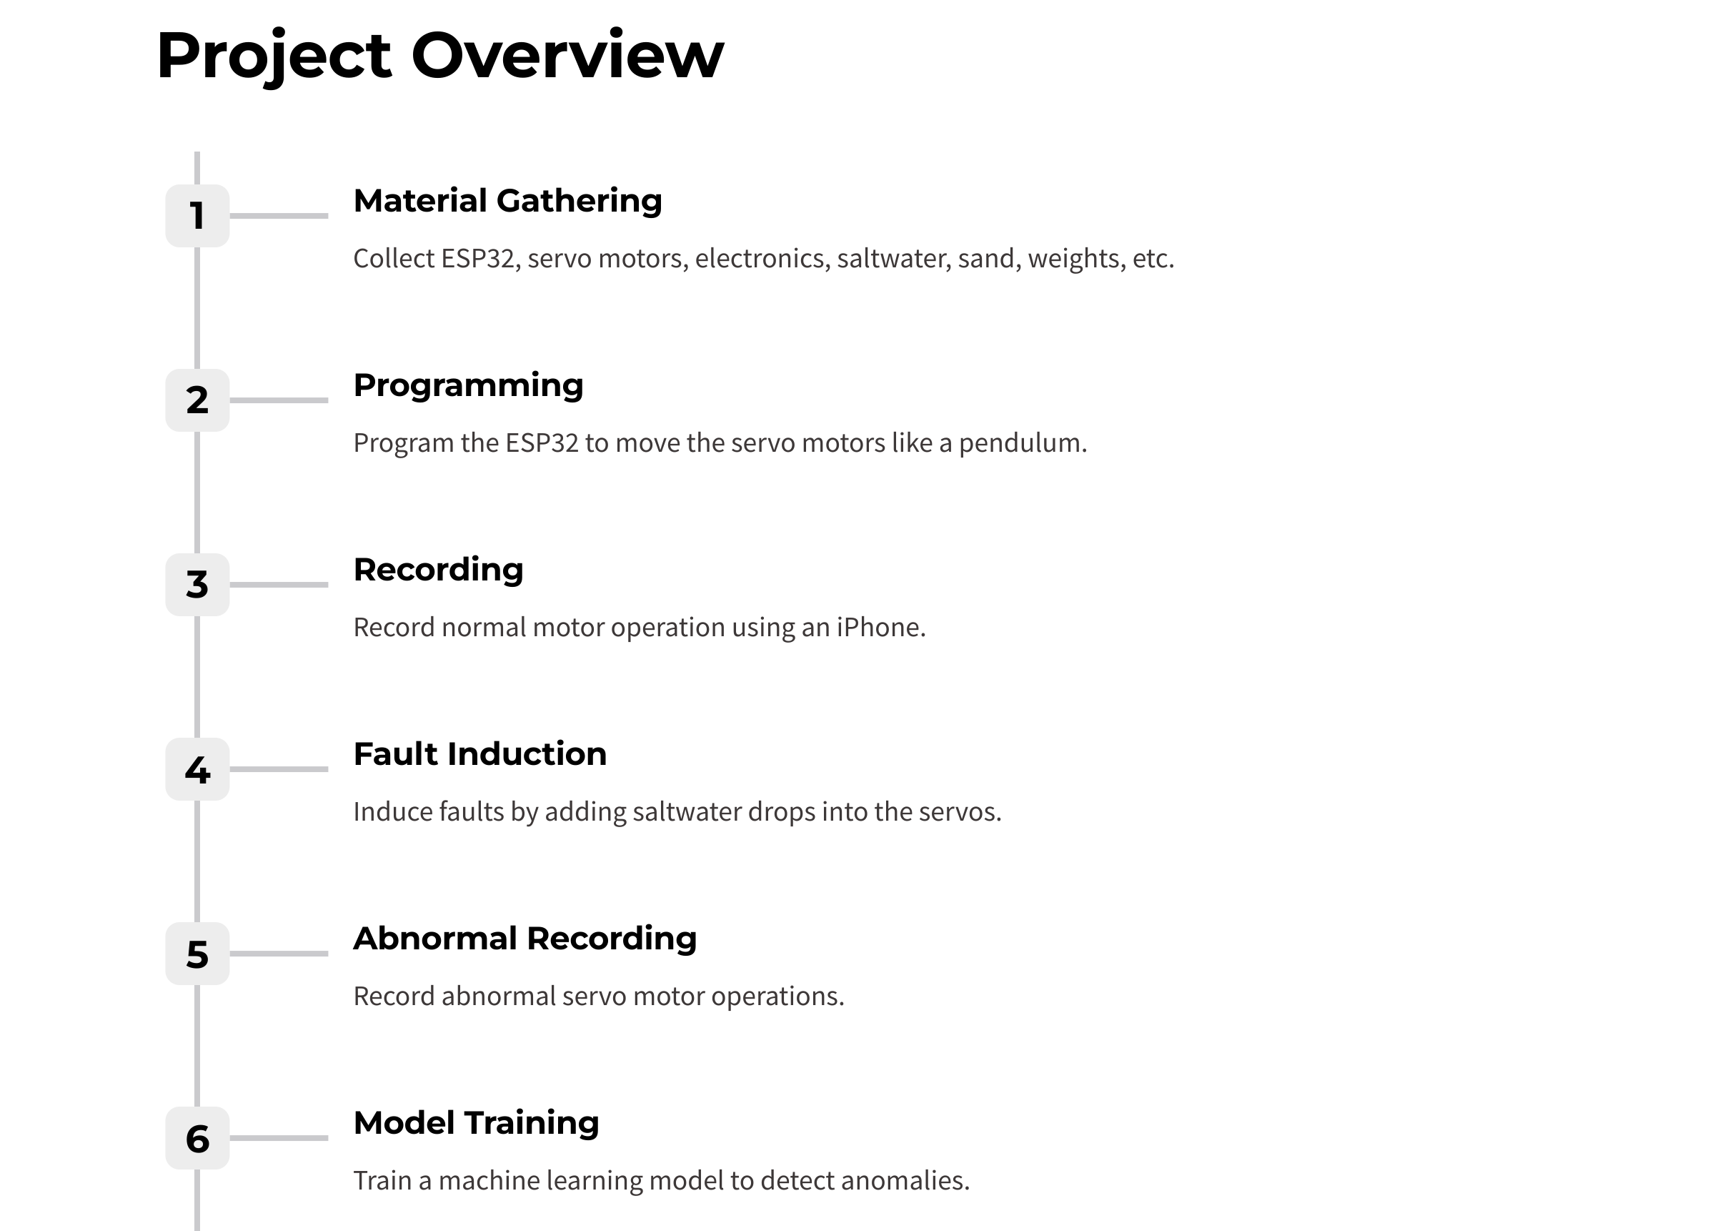

Slide 6
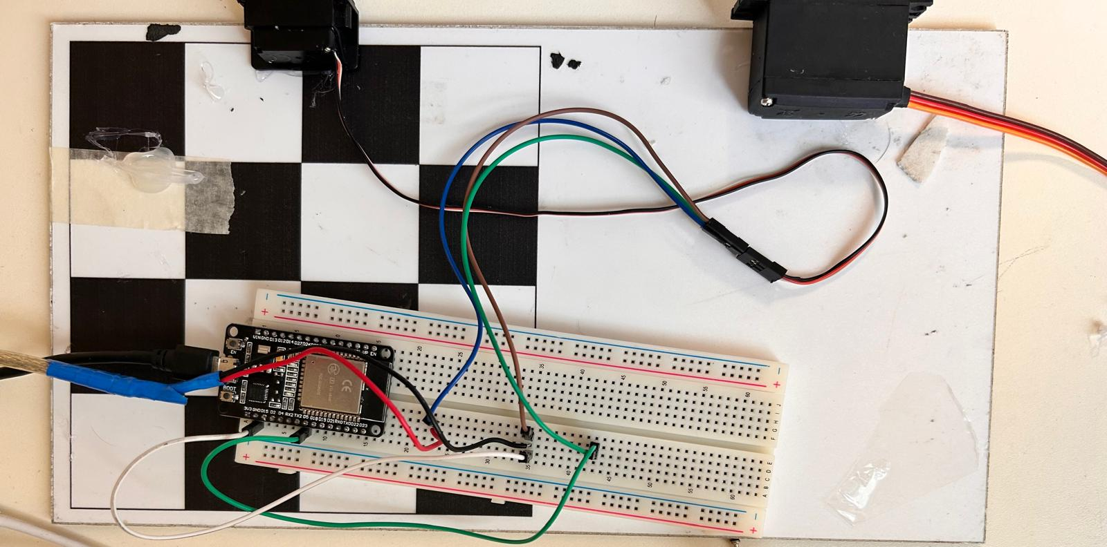
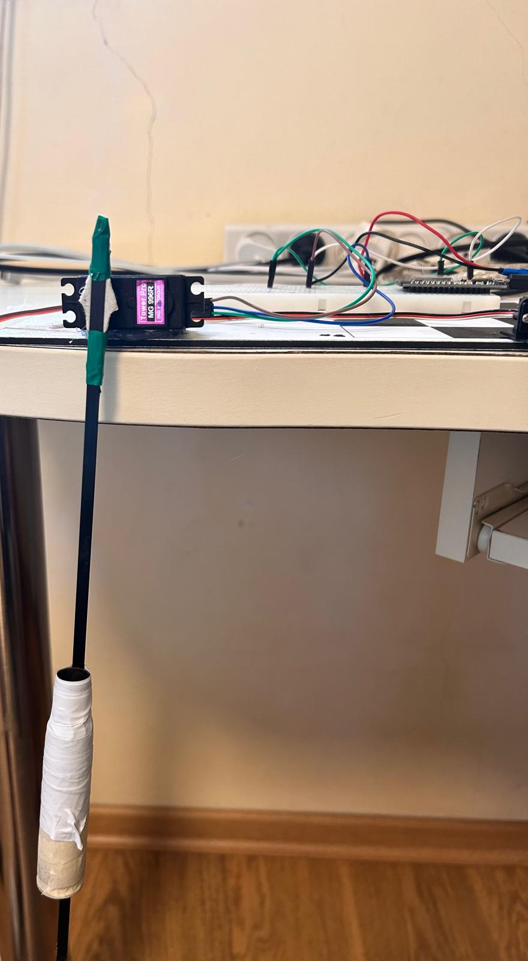
Project Overview

Slide 7
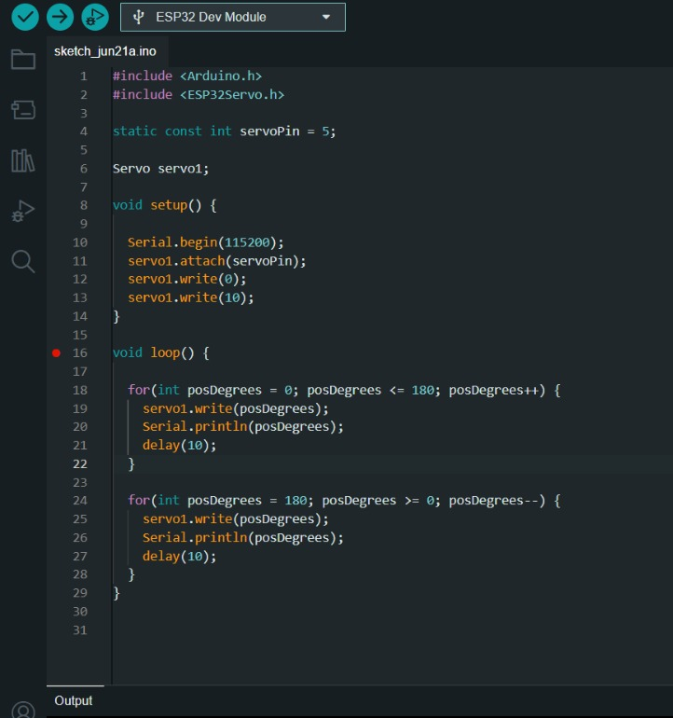

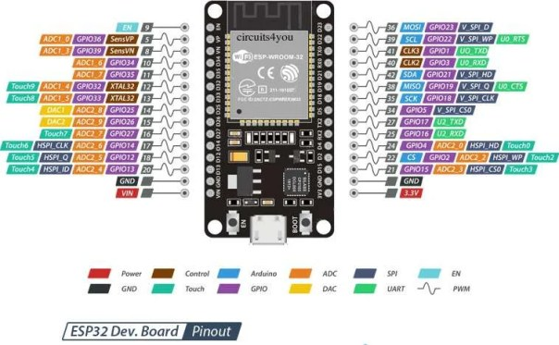
Controlling the servo – Arduino IDE

Slide 8

Audio examples:
with salt water
Working well

Slide 9
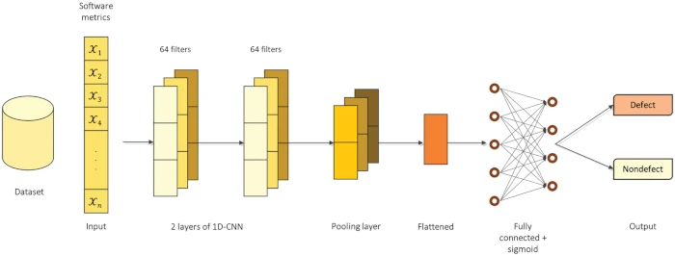

CNN training
Key Reasons:
Automatic Feature Extraction:
Good for audio type of data.
Detects localized patterns efficiently.
Efficiency:
Fewer parameters, reducing overfitting risks.
Faster computation, suitable for real-time applications.
Performance:
Higher accuracy in pattern recognition tasks.
Robust to variations in input data, capturing subtle anomalies.
Real-Time Deployment:
Optimizable for embedded systems like ESP32.
Lower latency, essential for real-time monitoring.

Slide 10
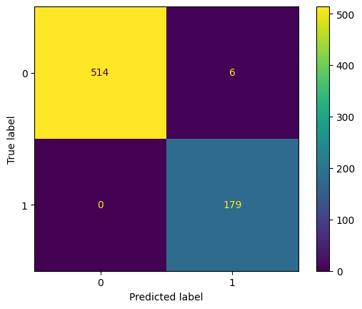
Model Evaluation:
Training set: 80%
Validation set: 10%
Test set: 10%
Great results over all!
Only 6 false positive!

